Slide 1
Smart Power For The Smart Home: Inverter Controls, Power Factor Corrections, And Peak Demand Reductions Critical Project Review
UC Irvine

Slide 2
Task 3 Statements of Work
Task 3. Load Signature Analysis for Wireless Monitoring and Control (UC Irvine)
1. UC Irvine will design and build the printed circuit board (PCB) for the loads monitoring system. The board should be able to measure the power and capture the waveform and send the information to the server via wireless. Also the board should be able to communicate with the smart meter to read the power information.
2. Preliminary test of the board in CalPlug
3. Develop the server to communicate with the power measuring board and do analysis to recognize the appliances.
4. Design a smartphone interface to show the loads information.
5. System optimization and algorithm optimization.
6. Test the loads monitoring system with the APF/Inverter.
7. Test in a smart house in UC Davis or Irvine.
8. Write interim and final reports on loads monitoring system.
Deliverable: Interim Report on Loads Monitoring System. Due Date: September 30, 2014
Deliverable: Final Report on Loads Monitoring System. Due Date: November 30, 2014

Slide 3
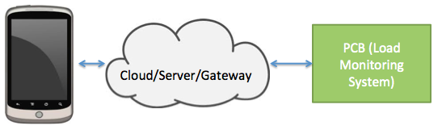
Task 3 Overview

Slide 4
Progress of the Project
Key Accomplishments:
Successfully obtained characteristic waveforms.
Board Design 80% (minor changes/updates)
Board to server communication implemented.
Mobile user interface completed.
Critical Milestones:
Final Board fabrication and populated.
Full system functional Preliminary test at CalPlug.
Increase load signature libraries.
Design transfer to UCD or test sites at UCI.

Slide 5
Critical Progress Since Last week
Site visit scheduled on 12/23 at UCD with Jonathan and Nelson.
LabView interface developed for system test and calibration for BOTH UCI and UCD.
Updates on data access outside of UCI perimeter.

Slide 6
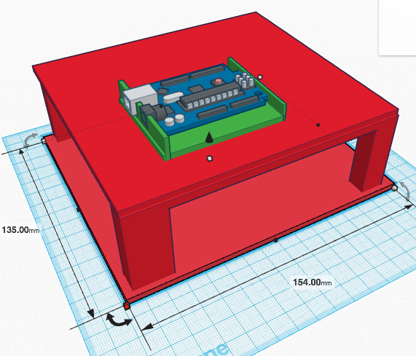
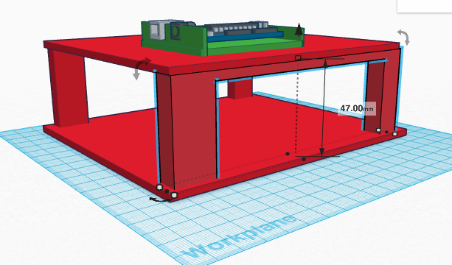
Form Factor
Approximately 150mm x 135mm x 50mm

Slide 7
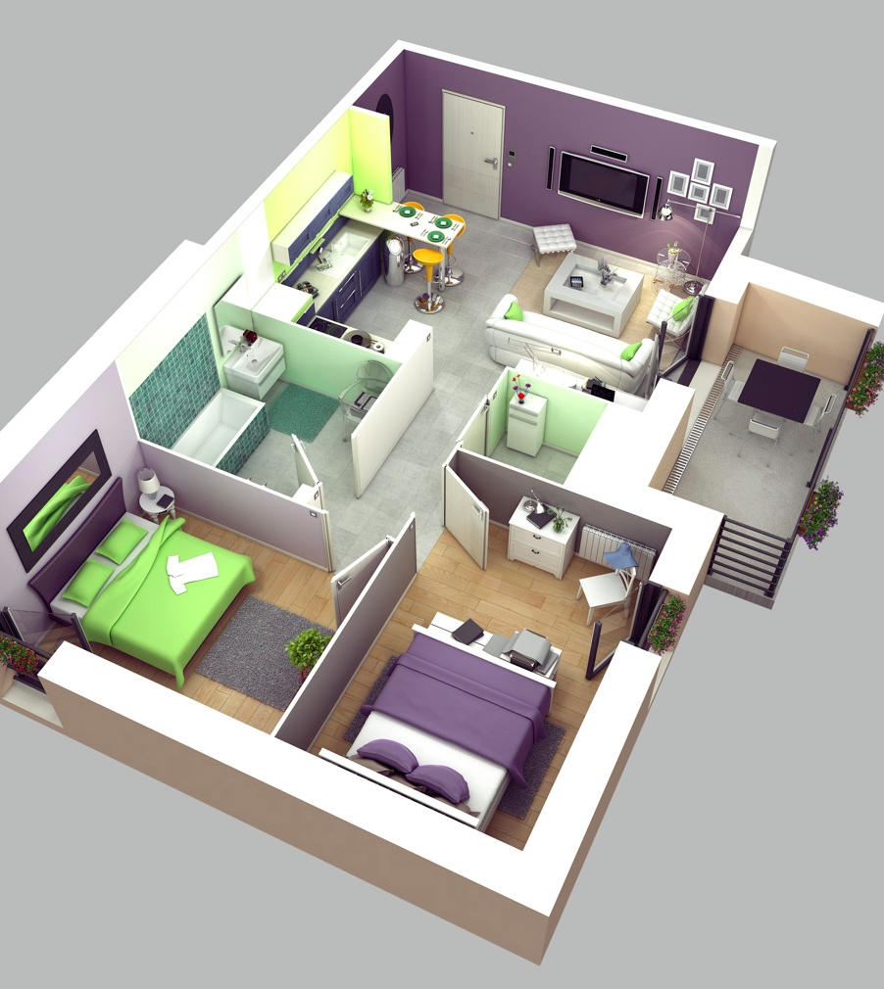
Installation Locations
Sectional Installations:
Bedroom
Kitchen
Living room
Bathroom (Maybe)
This allows us to make assumptions of what are the potential appliances that are plugged into the system.

Slide 8
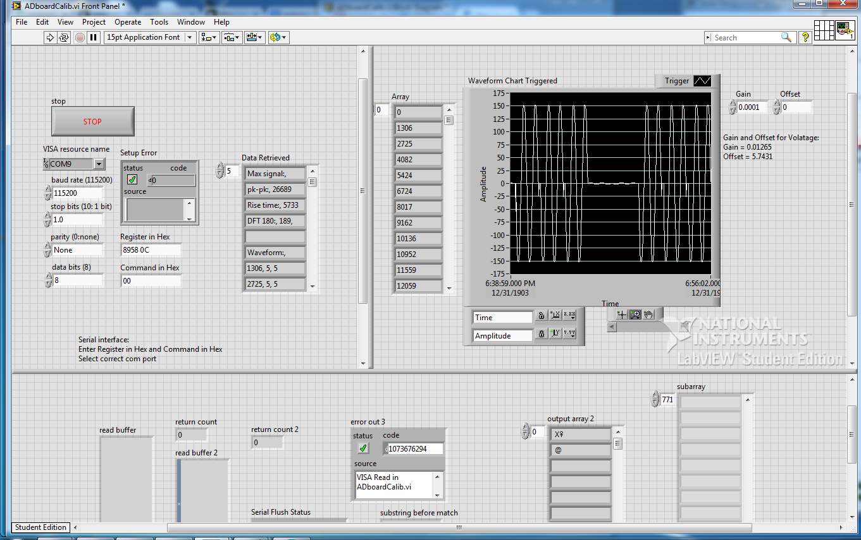
Test and Calibration Interface

Slide 9
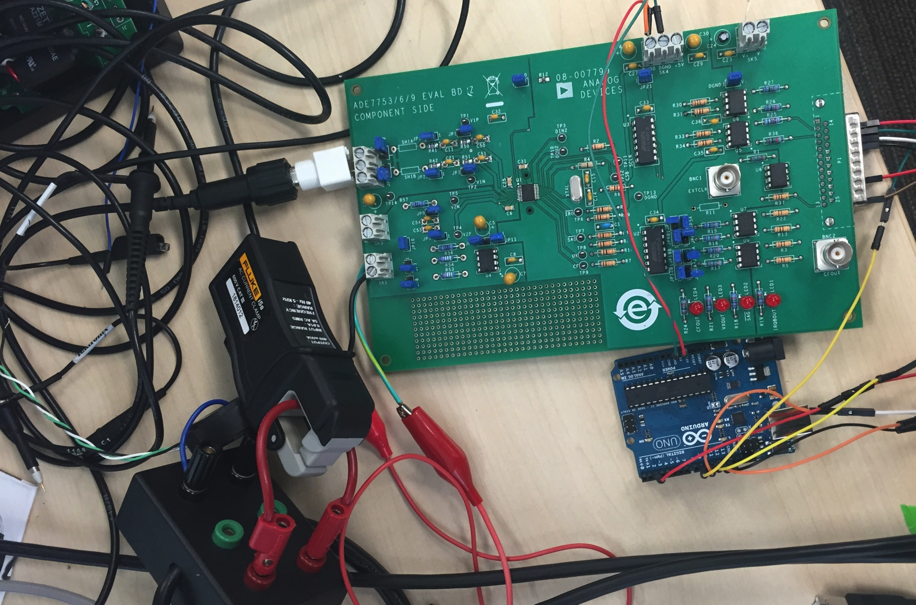
Current System Setup
Eval-ADE7763EB
Current Clamp
Breakout Box
Arduino Uno/Duo

Slide 10
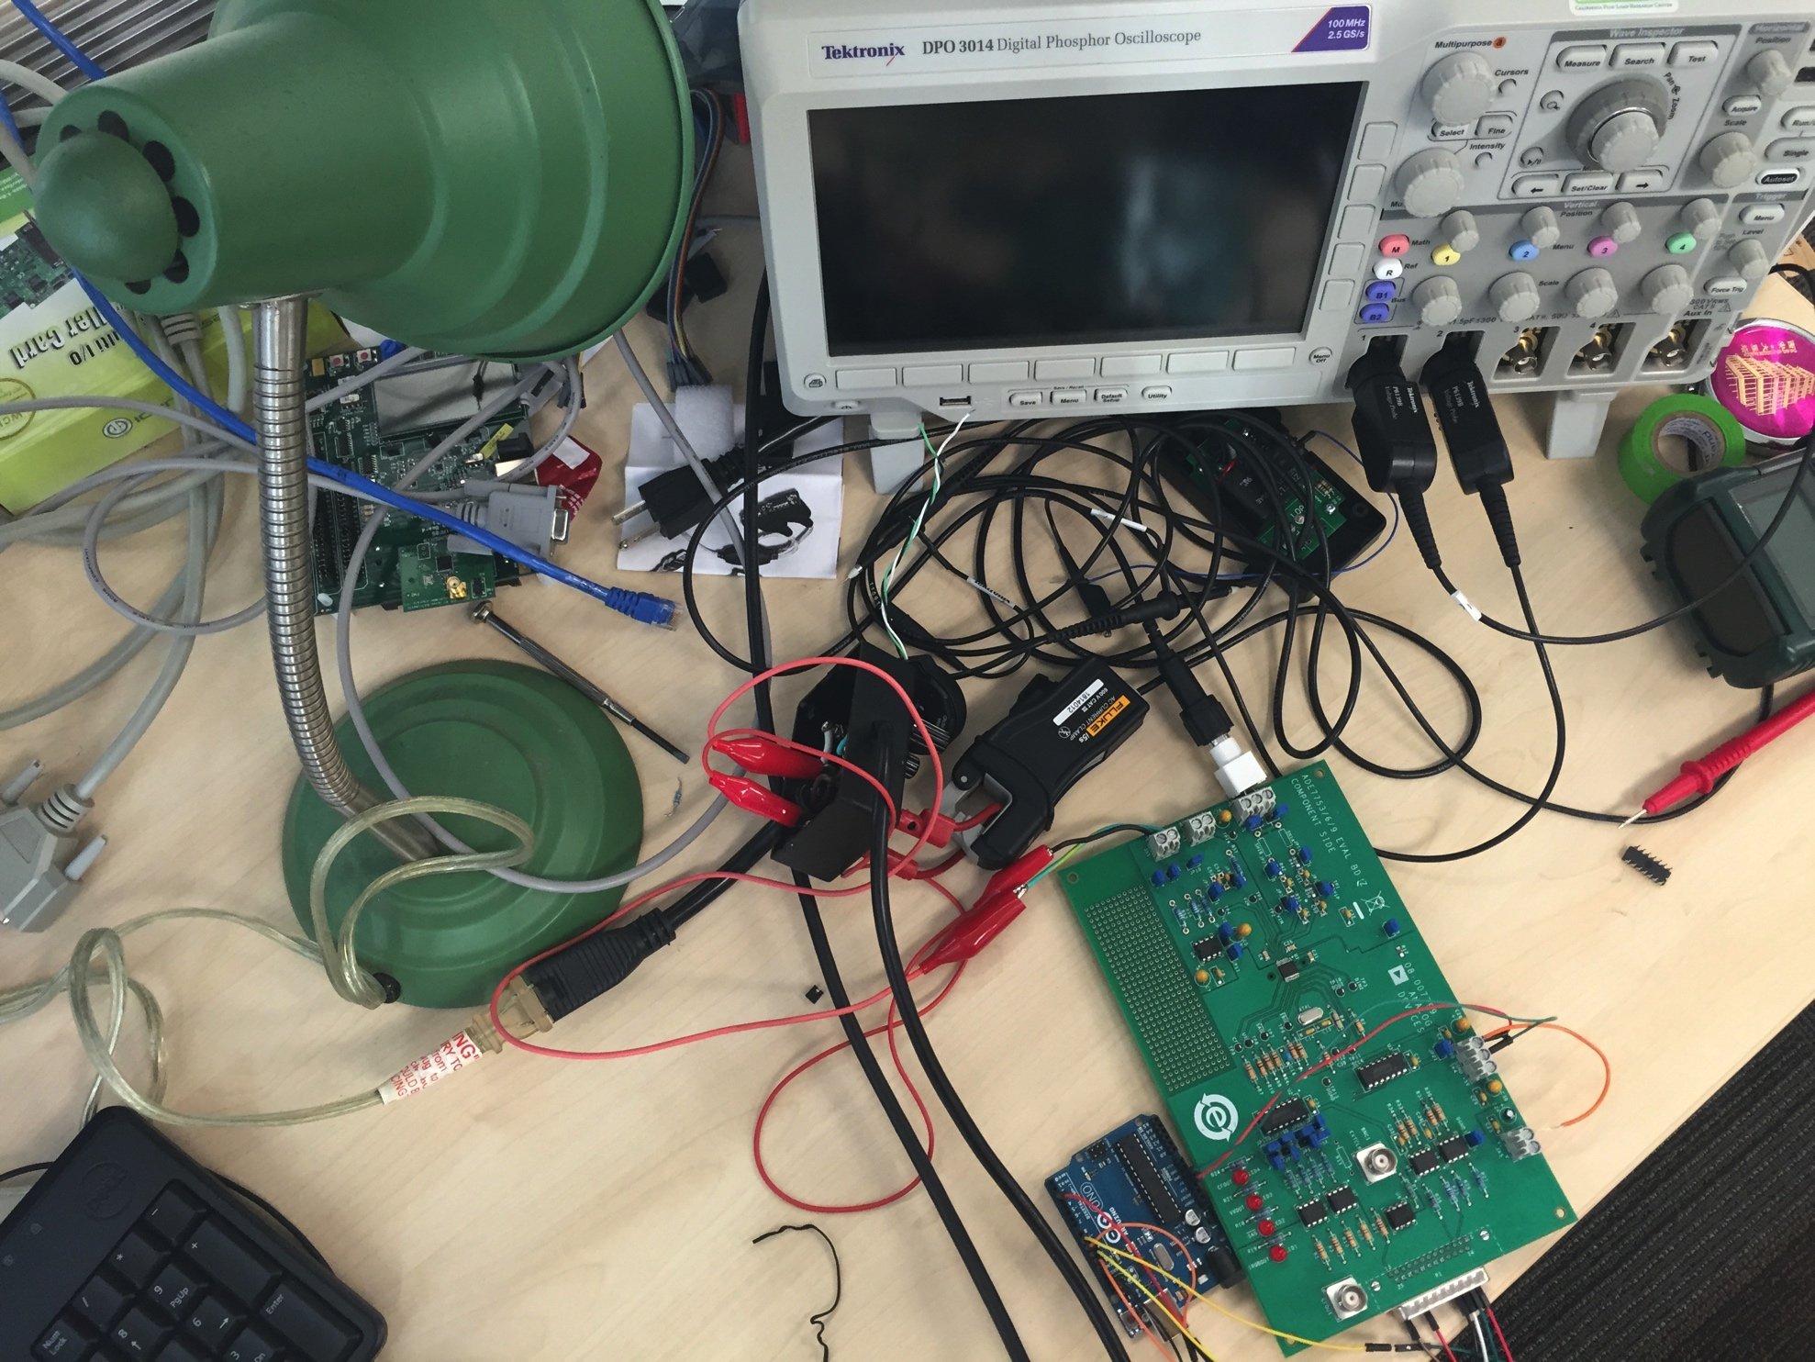
Current Test Setup
Load: lamp
Data Collection: Arduino ->PC
Communication verification: Oscilloscope
Power Analyzer to verify PF.

Slide 11
Methodology and Algorithm
Macro Load Signature:
Power:
Power Factor
Usage duration:
Micro Load Signature:
I/V curve
Time domain analysis
Rise and Fall time
Peak finding
Crossing
FFT
Harmonic analysis
Data Acquisition
3 periods of total 175 data points (Volt and Current)
Data Analysis: Peak, Τ, Phase (PF), FFT
Macro Characteristic matching
Micro Characteristic matching
Send Device ID, time stamp(s) and power to MySQL server
Server Data retrieving and Display

Slide 12
Sample Data Collected (Macro)

Slide 13
Sample Data Collected (Micro)
Note: Raw data displayed from data collected with a 16bit ADC downscaled to 12bit.
System is not calibrated. 12bit (4096) is mapped out to 240Vrms, max count = 3143,
Equivalent to 184.16Vrms.

Slide 14
Sample Data Collected (Micro)
Note: 18bit ADC not calibrated.

Slide 15
Sample Data Collected (Macro)
Note: Energy read from registers. Not calibrated.

Slide 16
Budget

Slide 17
Planned Schedule – Task 3 Overall

Slide 18
Planned Schedule – Task 3 Detailed

Slide 19
Planned Schedule – Task 3 Detailed
Note: In order to insert test data and results to a better conclusion,
the final report should be planned for a due date later than 11/30/2014.

